Slide 1

EVENT EMITTERS IN NODE.JS
Done By: Aakar Mutha , Jaeson Karter Joseph

Slide 2
1.
Introduction To Event Emitters

Slide 3
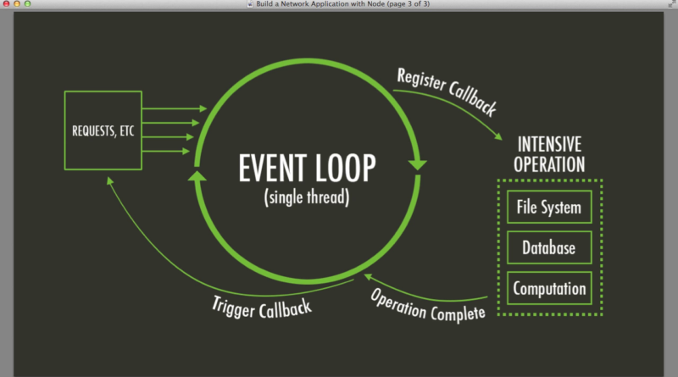
What are Event Emitters?
In Node.js an event can be described simply as a string with a corresponding callback. An event can be "emitted" (or in other words, the corresponding callback be called) multiple times or you can choose to only listen for the first time it is emitted.
Event emitters are objects in Node.js that trigger an event by sending a message to signal that an action was completed. JavaScript developers can write code that listens to events from an event emitter, allowing them to execute functions every time those events are triggered. In this context, events are composed of an identifying string and any data that needs to be passed to the listeners

Slide 4
What Is an Event?
A whole software paradigm revolves around events and their usage. Event-driven architecture is relatively common nowadays and event-driven applications produce, detect, and react to different kinds of events.
In event-driven programming, an event is the result of a single or multiple actions. This can be a user action or a periodic output from a sensor, for example.
You can view event-driven programs as publish-subscribe models where a publisher triggers events and subscribers listen to them and act accordingly.
For example, let's assume that we have an image server where users can upload images. In event-driven programming, an action such as uploading the image would emit an event. To make use of it, there would also be 1..n subscribers to that event.
Once the upload event is fired, a subscriber can react to it by sending an email to the administrator of the website, letting them know that a user has uploaded a photo. Another subscriber might collect information about the action and persist them in the database.
These events are typically independent of each other, though they could also be dependent.

Slide 5
2.
Steps Involved in Making Event Emitters

Slide 6
Step 1 — Emitting Events
In this step, we’ll explore the two most common ways to create an event emitter in Node.js. The first is to use an event emitter object directly, and the second is to create an object that extends the event emitter object.
var events = require("events"),
emitter = new events.EventEmitter(),
username = "admin",
password = "admin";
// an event listener
emitter.on("userAdded", function (username, password) {
console.log("Added user " + username);
});
// Emit an event
emitter.emit("userAdded", username, password);

Slide 7
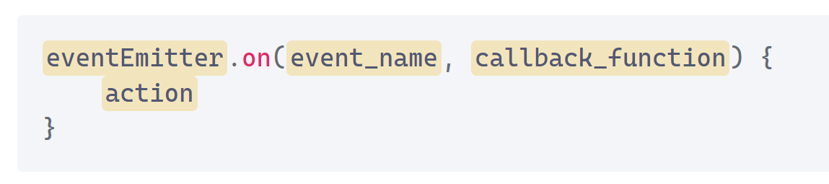
Step 2 — Listening for Events
Node.js allows us to add a listener for an event with the on() function of an event emitter object. This listens for a particular event name and fires a callback when the event is triggered. Adding a listener typically looks like this:
var events = require("events"),
emitter = new events.EventEmitter(),
username = "admin",
password = "admin";
// an event listener
emitter.on("userAdded", function (username, password) {
console.log("Added user " + username);
});
// Emit an event
emitter.emit("userAdded", username, password);

Slide 8
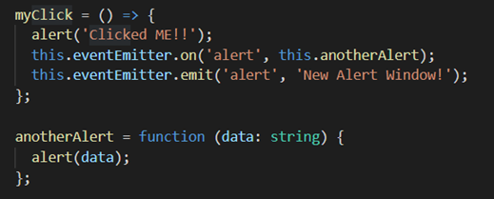
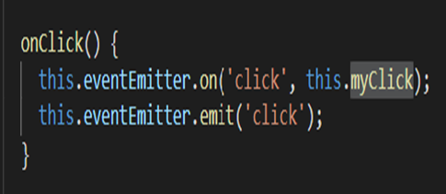
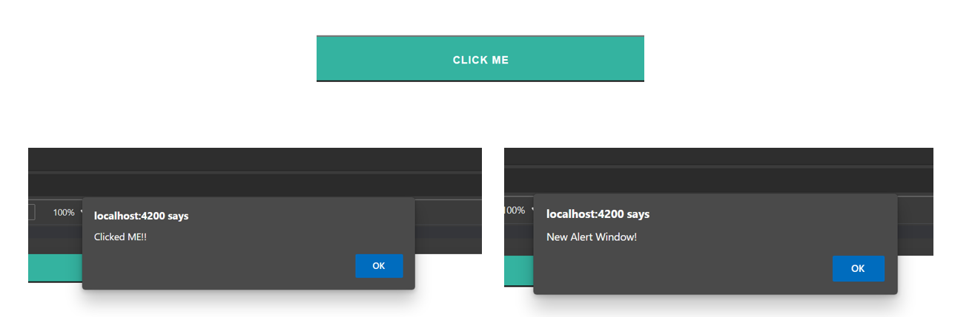
Step 3 — Capturing Event Data
The data is also passed along via the emitted events. Let's look at how we can record the data that comes with an event.

Slide 9
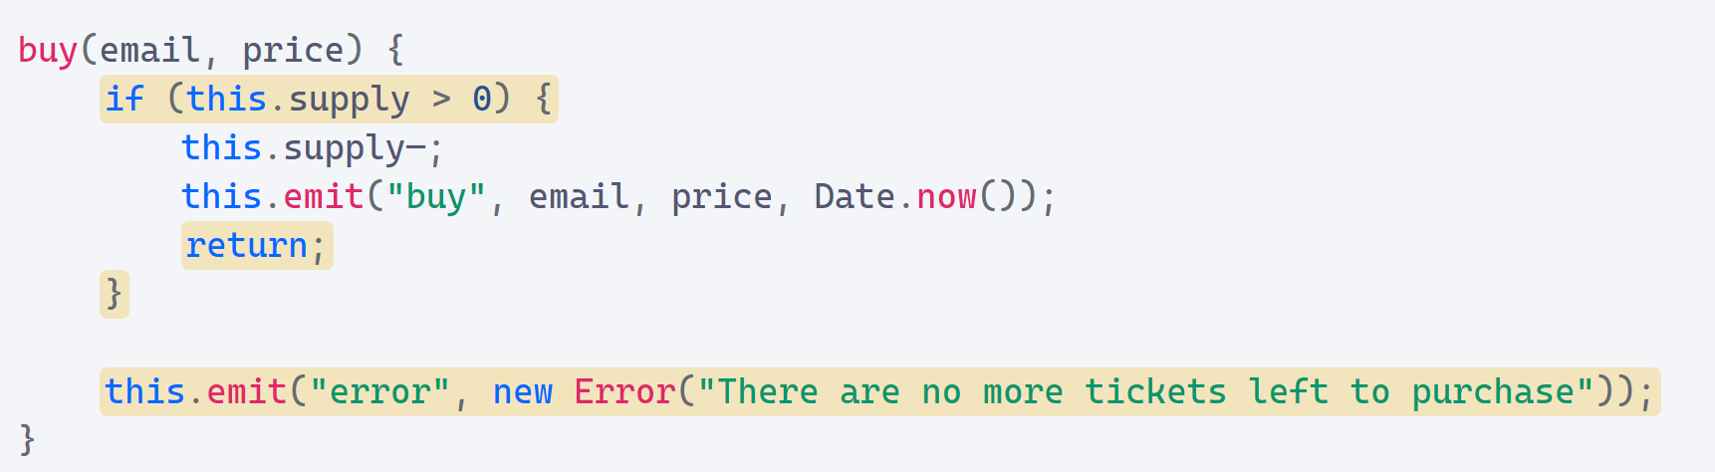
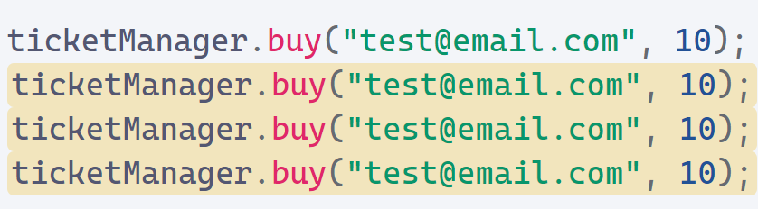
Step 4 — Handling Error Events
If an event emitter is unable to complete its task, it should generate an event to indicate that the task was unsuccessful. An error event is the typical mechanism for an event emitter in Node.js to report failure.

Slide 10
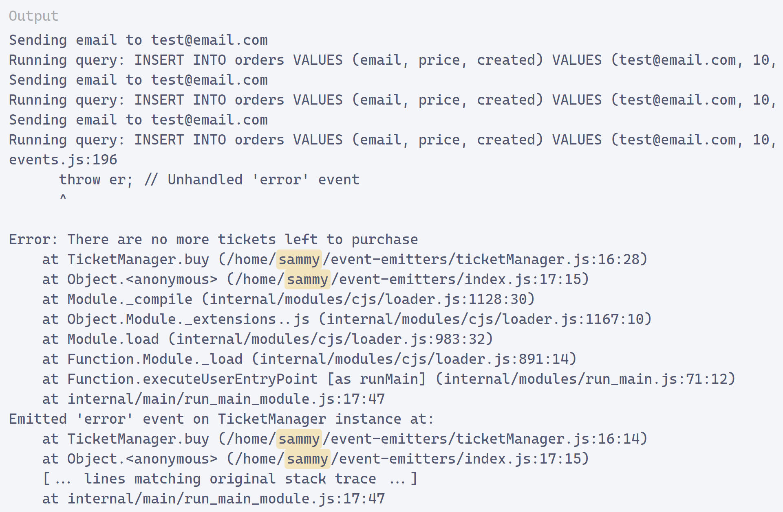
Continuation….

Slide 11
3.
Methods of an Event Emitter

Slide 12
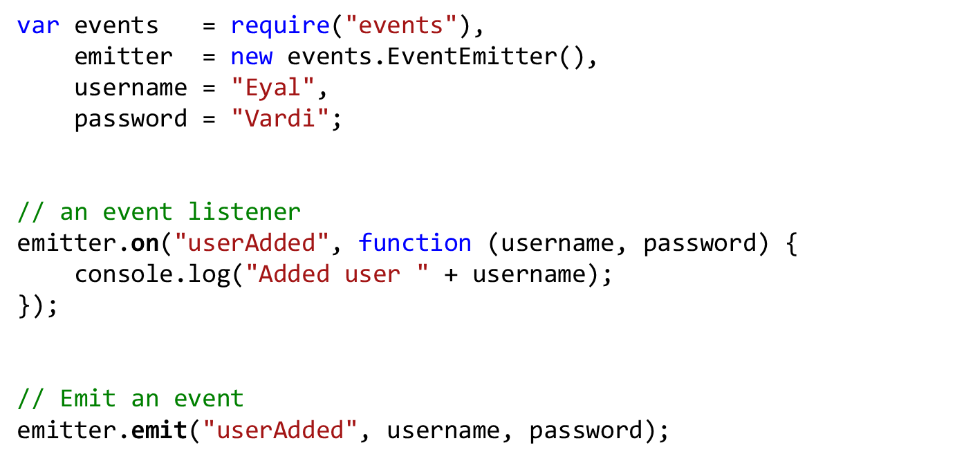
Event Emitter

Slide 13
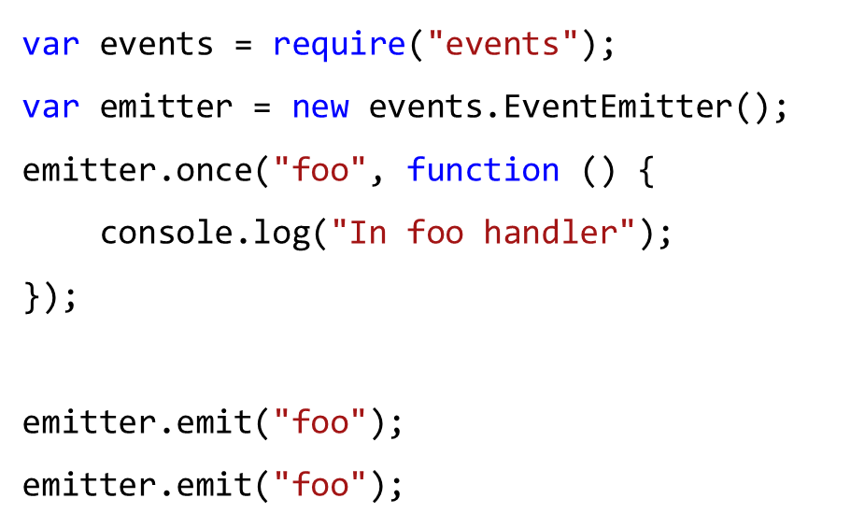
One-Time Event Listeners
Sometimes you may be interested in reacting to an event only the first time it occurs.

Slide 14
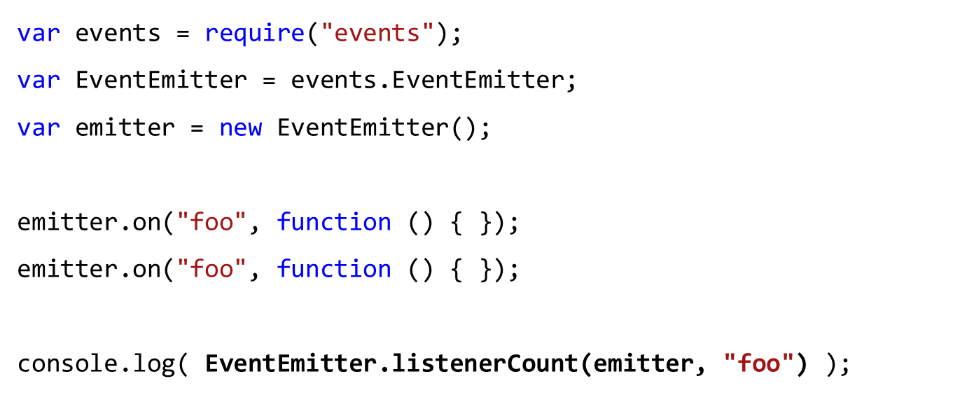
Inspecting Event Listeners

Slide 15
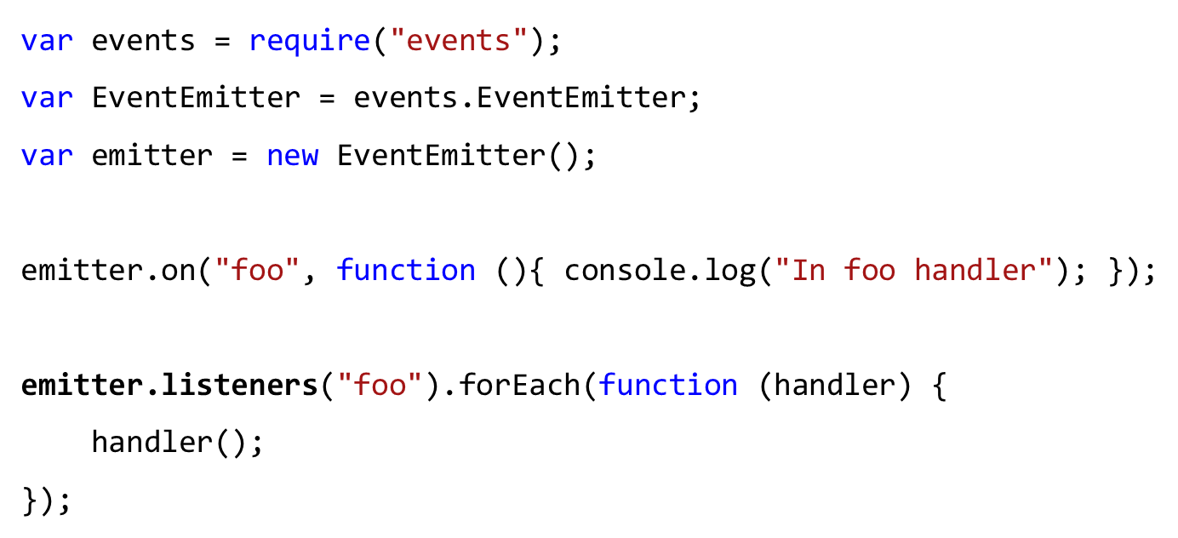
The newListener Event
Each time a new event handler is registered, the event emitter emits a newListener event.

Slide 16
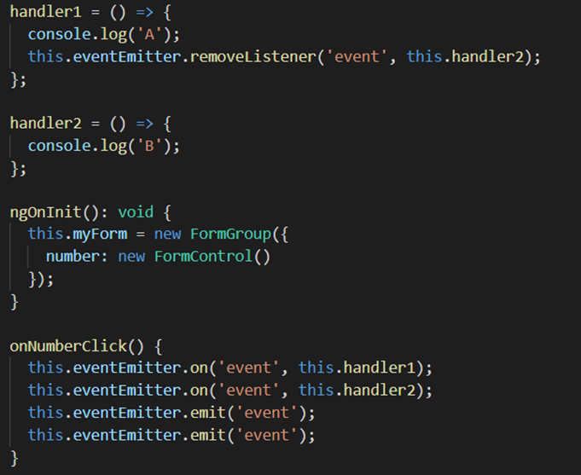
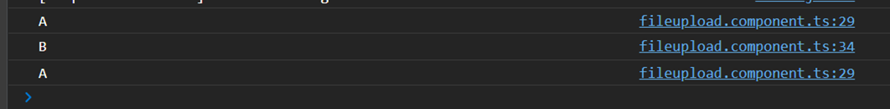
Removing Event Listeners
An event listener can be removed after it’s been attached to an event emitter.
emitter.removeAllListeners([eventName])
emitter.removeListener([eventName],[handler])

Slide 17
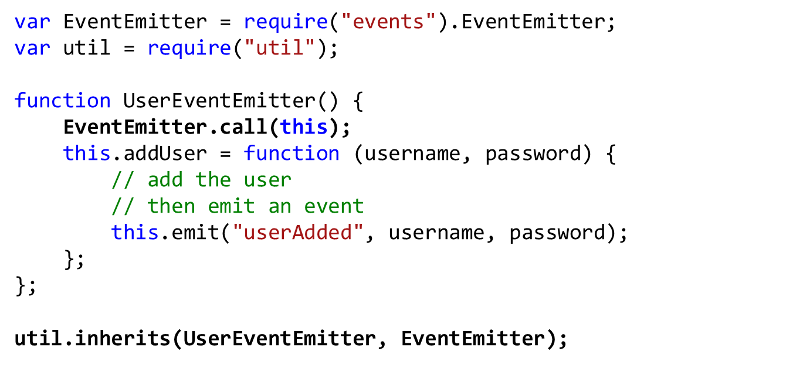
Inheriting from Event Emitters
You can create custom objects that inherit from EventEmitter and include additional application-specific logic.

Slide 18
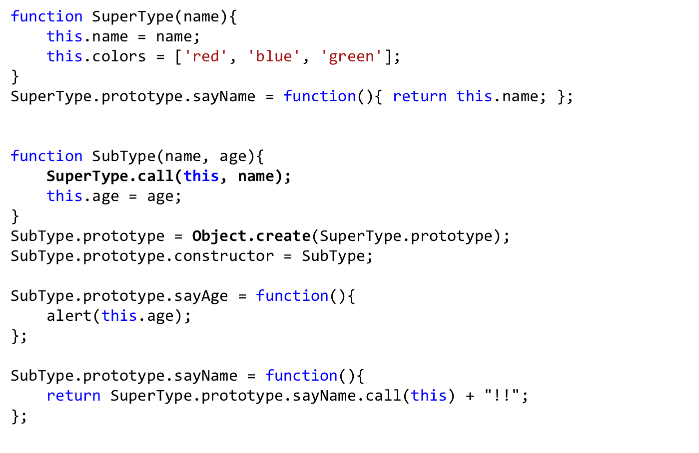
Full Solution Inheritance

Slide 19
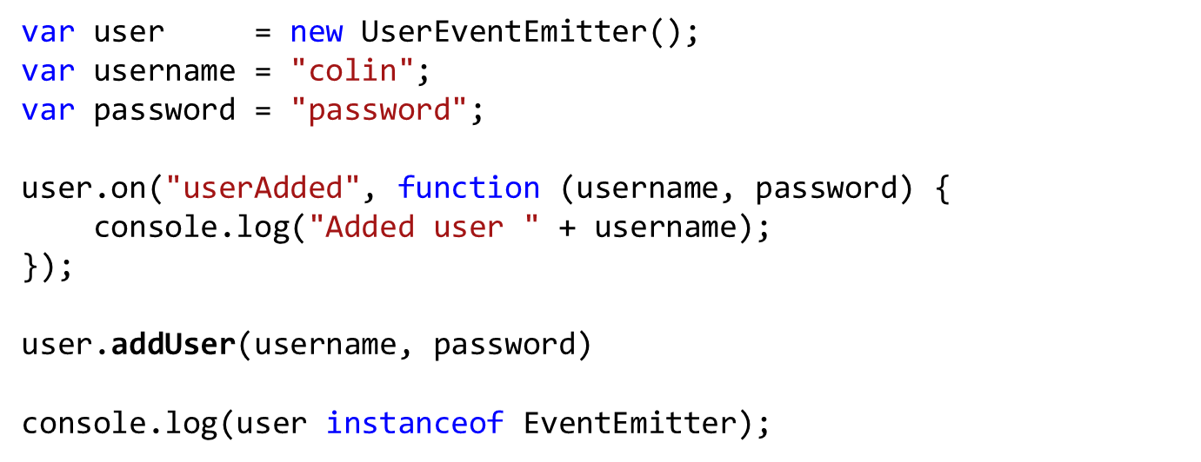
Using a Custom Event Emitter

Slide 20
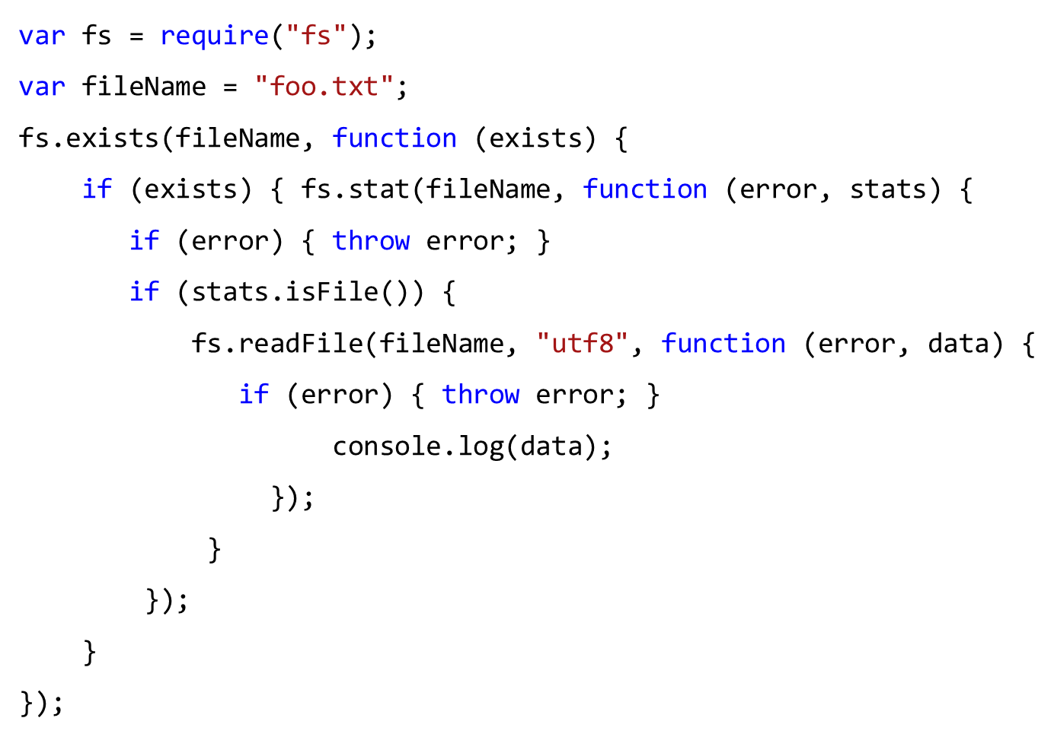
Using Events to Avoid Callback Hell

Slide 21
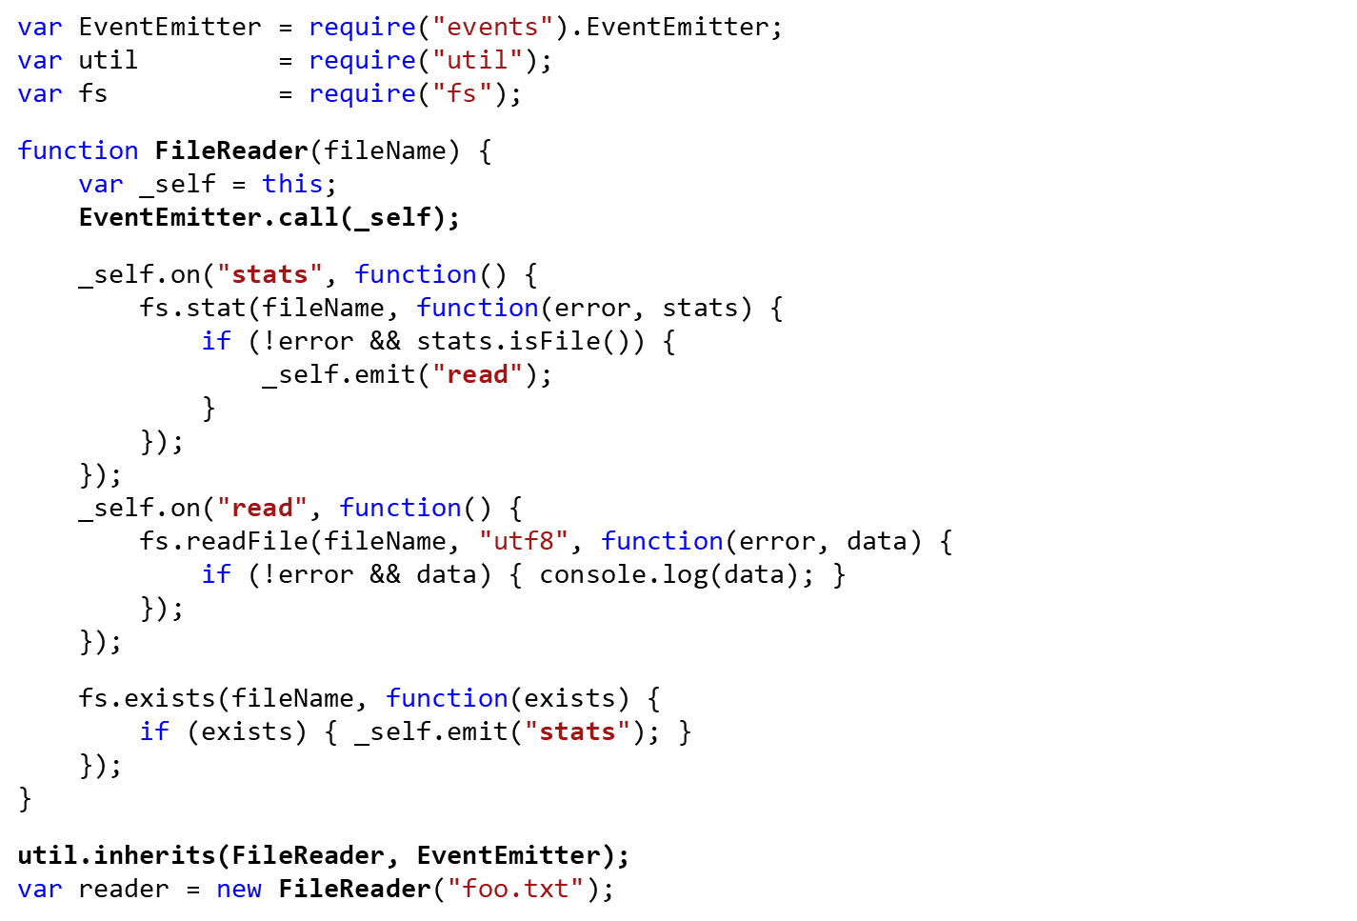
Continuation

Slide 22
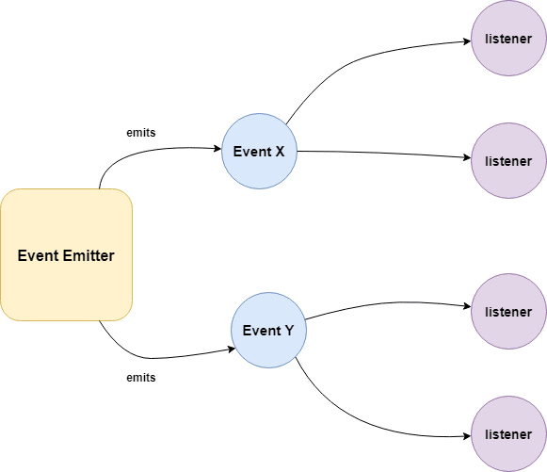
How does it work?
Event Emitter emits the data in an event called message
A Listened is registered on the event message
when the message event emits some data, the listener will get the data.
Building Blocks:
.emit() - this method in event emitter is to emit an event in module
.on() - this method is to listen to data on a registered event in node.js
.once() - it listen to data on a registered event only once.
.addListener() - it checks if the listener is registered for an event.
.removeListener() - it removes the listener for an event.

Slide 23
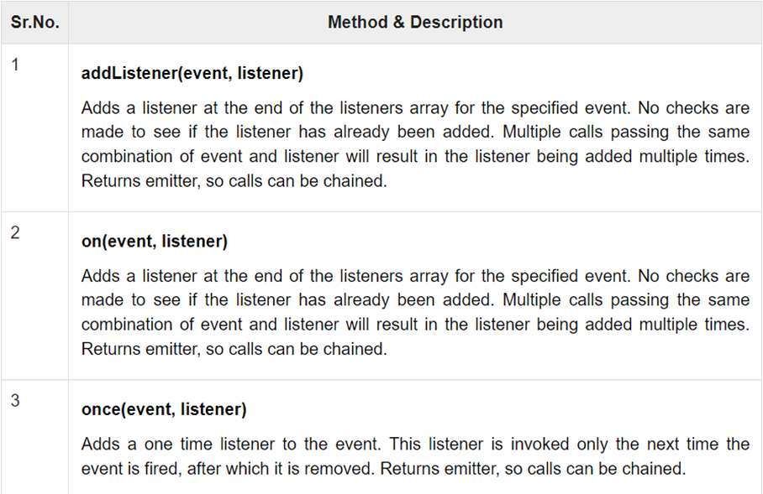
Methods & Description

Slide 24
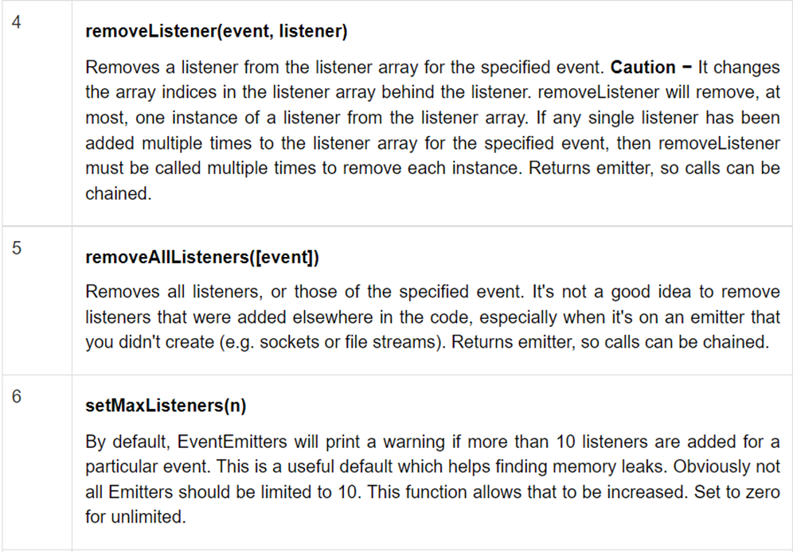
Methods & Description

Slide 25
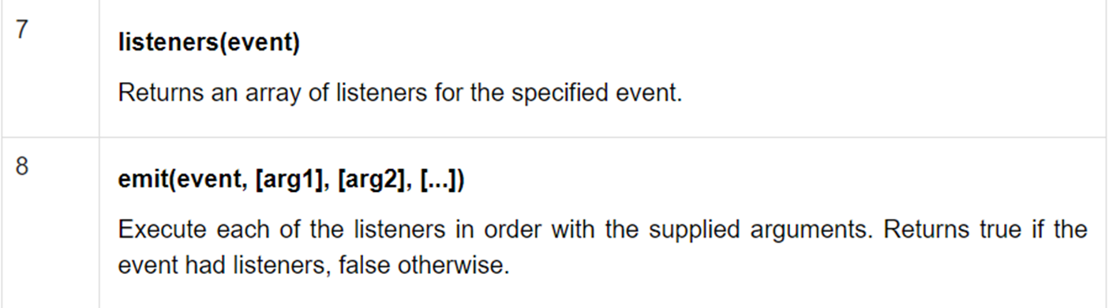
Methods & Description

